Slide 1





Welcome to the “Step Up” – NHS live online career challenge
1. Today’s event – 45 minutes
Watch the live NHS briefing session to meet the team and find out how to solve this career challenge.
Communicate with us using the chat function only – Q&A.
If you have any technical difficulties, please email info@digdata.online.
This call is being recorded and all attendee videos and microphones are disabled.
Respectful and appropriate behaviour throughout the briefing session.
A positive attitude and a willingness to learn.
There will be several opportunities throughout today’s session to ask questions using the chat function.
Learn how NHS use data every day to make decisions and solve problems.
Receive a virtual work experience certificate
Gain valuable data literacy skills.
An extra curricular experience to add to your CV, LinkedIn profile and job applications.
2. What we need from you
3. How will you benefit from completing this challenge?

Slide 2
Digdata – Step Up
NHS Online Live Career Challenge
4th March 2025
Turning data into insight: Building awareness of mental health prescribing

Slide 3





Meet the team
Amelia Noonan, Data Scientist, NHS England
Adnan Shroufi, Senior Data Scientist, NHS Business Services Authority
James Harrison, Principal Knowledge Transfer Facilitator, OHID, DHSC
Sarah Blundell, Lead for Analytical Development, NHS England

Slide 4

When was the National Health Service (NHS) established?
A
B
C
1947
1948
1949
Notes:
Birthday is the 5th July
Aneurin Bevan Nye Bevan was the first minister for health
Role to make a secure environment for health – prior to this health was a lottery – some places depended on charity hospitals, others covered by LA rates, others had to pay or via insurance schemes.

Slide 5
In the year April 2023 to March 2024, how many attendances were there at Accident and Emergency departments in England?
A
B
C
23 Million
20 Million
26 Million
Notes:
Healthcare provision in a hospital can be measured across
Elective care – patients are booked in to see a clinician – planned
Emergency – patients attend hospital unexpectedly
This figure is impacted by a variety of determinants of health that span genetics, where we live, what we choose, the environments we live in, all the way through to the macor socio economic systems that impact us

Slide 6
What is the annual budget for the NHS?
A
B
C
£100 Million
£1 Billion
£181 Billion
Notes:
From a total health and social care budget of 190 billion
Public health grant to local authorities is 3.6 billion – health isn’t just aboyut treatment – or as we refer to it downstream – we often have to focus on prevention (upstream) so that people get sicker later in life and we don’t spend as much time and money on treatment focussed

Slide 7
How much is the NHS data worth per year?
£2bn
£6bn
£9bn
A
B
C
Source: 2019 Ernst and Young
Notes:
The value of NHS data in benefits to the NHS system and to patients – as discovered by Ernst and young 2019
Shows the value of utilising data to create a system which is using the insight to make itself and the outcomes for patients better – the cost of not utilising it therefore is considerable in both economic and also health outcome terms

Slide 8
According to AnalystX how many Data Analysts work in the health and care system?
7,012
8,345
9,974
A
B
C
AnalystX Observatory - AnalystX - FutureNHS Collaboration Platform
Notes:
They crunch all the data – and attempt to be innovative and interesting and make the data count when decision makers are using it – data needs to have impact

Slide 9

What are you hoping to learn from this challenge?
In the chat box, let us know the things you are hoping to learn
Notes:
Add to the chat you hopes for this challenge

Slide 10

What services does the NHS provide?
In the chat box, let us know which services you think the NHS help to deliver
Notes:
I might remove this

Slide 11








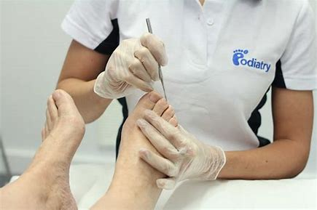
What services does the NHS provide?
Emergency & Non-Emergency inpatient care
District Nursing
Health Visiting
Outpatient care
Opticians
General Practitioners
Dentistry
All provide data…
Pharmacies
Podiatrists
Notes:
Data results from 1:1 interactions within the system – collated and then analysed to identify patterns and potential initiatives to improving health

Slide 12


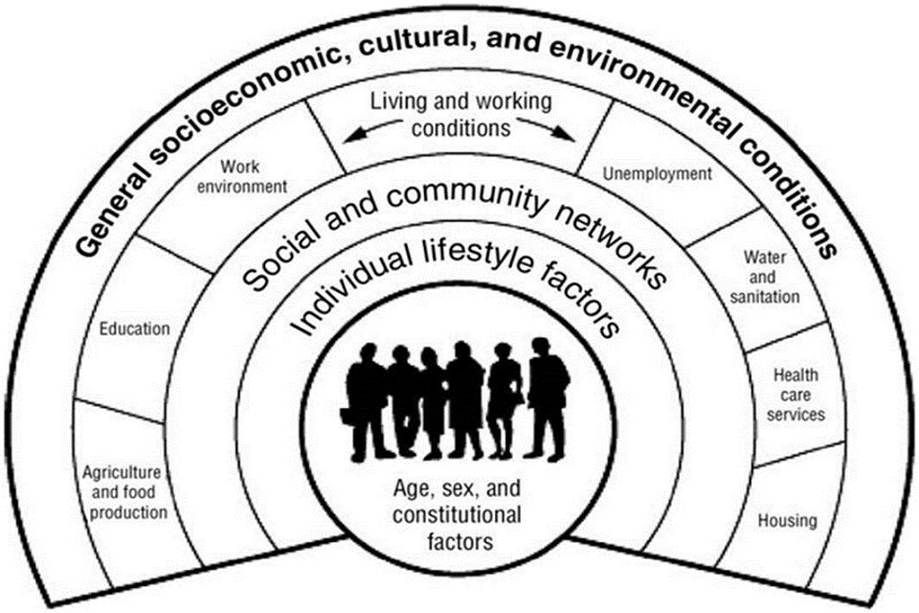







Health Intelligence
Public Health Intelligence
Health Protection
Surveillance
Outbreak prevention and control
Monitoring threats
Immunisation
Health Improvement
Needs assessment
Programme development
Partnership working
Evidence and evaluation
Health services
Health service commissioning
Health and social care service prioritisation
Equity
Quality
Evaluation
Selected extracts from Functions and standards of a Public Health system, Faculty of Public Health
https://www.fph.org.uk/media/3031/fph_systems_and_function-final-v2.pdf
Data
Socio-economic
Demographic
Place
Lifestyle & Behaviours
Health and Social Care
Disease incidence and prevalence
Wider determinants of health
Health and Social care systems
Notes:
This is the type of process of building data repositories and how it is used in varied ways

Slide 13
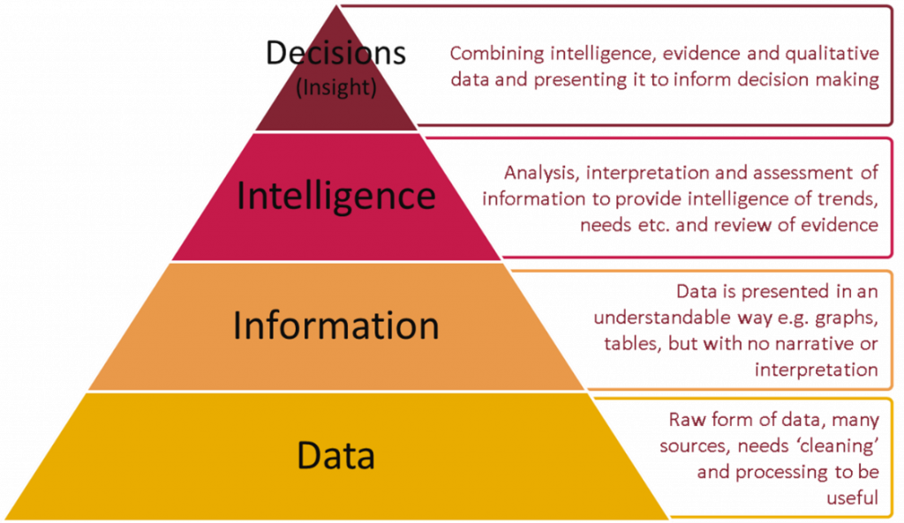
Data to decisions
Notes:
Data to decisions – the process of why we collect and analyse

Slide 14
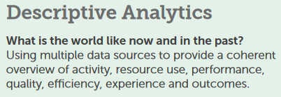
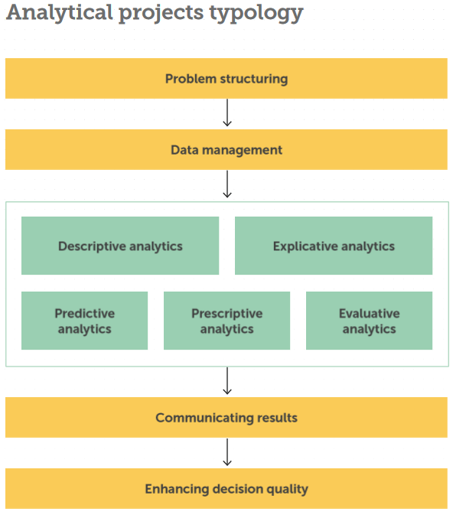
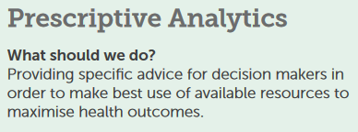
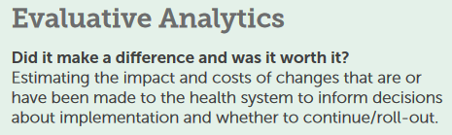
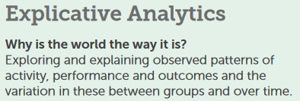
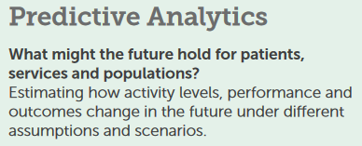
Types of analysis
Advancing analytics in the NHS
Notes:
The types of analysis we can do with data – more to an analyst than simply describing something
Analysis is part of a pathway – it isn’t a resource on its own – it should do something and should lead somewhere

Slide 15
Digital, Data and Technology (DDAT) career roles
Total Number of Data Professionals working across Health and Social Care in England 10,275
Data Analysts 8,345 (Including performance analysts)
Data Engineers 1,183
Data Scientists 515
Data Governance Manager 127
Data Ethicist 13
Analytics Engineer 73
Machine Learning Engineer 19
Source AnalystX Observatory - AnalystX - FutureNHS Collaboration Platform
Notes:
Variety of data roles within the NHS – emerging area
Add the session next day information RE recruitment – briefing and focus on the event – add QR code and get information
Increase engagement across the group – asking questions of each slide

Slide 16

Event
Live online recruitment briefing:
Data placement and graduate opportunities in the NHS
Wednesday 5th March @ 6:30 PM via MS Teams
Use the QR code to join

Slide 17









What technology do we use?
Notes:
Tech used
TO ADD????
Github

Slide 18
Career challenge
Turning data into insight: Building awareness of mental health prescribing
The NHS is experiencing an unprecedented surge in demand for mental health services. Long waiting times, particularly for young people are placing a strain on patients and providers alike. In parallel, the use of prescription medications, especially for managing anxiety and depression, has seen a marked increase.
This challenge offer students the opportunity to delve into datasets reflecting drug usage trends to build awareness and inform decision making using NHS data to improve patient care.
Data Analysis– designed for students who are starting their data literacy journey
Explore data on the prescription rates of common mental health medications.
Data reporting – designed for students who would like to further develop their programming skills
You are a public health officer and want to better understand antidepressant prescribing trends over time.

Slide 19
Challenge A: using excel to analyse the data
Transforming and Aggregating Data
Question 1: Nationally, calculate the top 10 prescribed anti-depressants sorted from biggest from smallest.
Question 2: Calculate the national cost of Mirtazapine prescribing
Question 3: What is the spend of Sertraline hydrochloride prescribing in the Midlands region?
Question 4: How many anti-depressant items were prescribed nationally?
Notes:
Challenge A: data analysis using excel – one month worth of prescribing data

Slide 20
Challenge A: using excel to visualise the data
Visualising Data
Question 1: Create a horizontal bar chart of the top 5 most prescribed drugs in December 2024, arranged in order.
Question 2: Create a vertical bar chart showing the total cost of sertraline hydrochloride prescribing in the North East region.
Question 3: Create two vertical bar charts for comparison. First, create a bar chart showing the total antidepressant prescribing (items). Second, create a bar chart that shows the total antidepressant prescribing cost.
Question 4: Create an ordered bar chart showing the 10 most prescribed antidepressants (items). Second, create an ordered bar chart that shows antidepressants with the greatest total prescribing cost.
Notes:
Challenge A: data analysis using excel – one month worth of prescribing data

Slide 21
Challenge A: presenting your findings
Data Metrics and Insight
Create a PowerPoint presentation that describes the analysis
Describe the trend of each chart and compare the charts against each other
Create two pivot tables for comparison. First, create a pivot table showing the total antidepressant prescribing per region. Second, create a pivot table showing the antidepressant prescribing cost per region.
Describe some regional variation and contrasts.
By now you may have noticed there are contrasts between antidepressant prescribing volumes and costs.
Highlight and describe any differences between the charts.
Notes:
Challenge A: data analysis using excel – one month worth of prescribing data

Slide 22
Challenge B: using R to analyse the data
Analysing your data
You will have four questions on transforming and aggregating data
You will have three questions on visualising data
You will have five questions on generating data metrics and insight
GitHub location: GitHub - nhsbsa-data-analytics/dig-data-step-up: Content for Dig Data Step Up Career Challenge
Please refer to the Answers section in the GitHub to self-assess your progress
Presenting your findings
Longitudinal analysis into anti-depressant prescribing
Extension work: anti-depressant case studies
Report submission
1. Send HTML file to Info@digdata.online

Slide 23
Challenge C: using Python to analyse the data
Analysing your data
You will have three questions on transforming and aggregating data
You will have three questions on visualising data
You will have six questions on generating data metrics and insight
You will receive a how to guide on how to access the data for Python
Presenting your findings
Longitudinal analysis into anti-depressant prescribing
Extension work: anti-depressant case studies
Report submission
1. Send the IPYNB file to Info@digdata.online

Slide 24
Data Challenge
Any questions?

Slide 25
Data Challenge
THANK YOU
AND
GOOD LUCK

Slide 26

“Step Up” – NHS live online career challenge
1. What happens now?
Digdata will send you an email containing:
YouTube link - recording of this session.
WeTransfer link containing files to download:
Challenge A – dataset, How to Guide, Excel cheat sheet, PPT presentation
Challenge B – How to Guide, R Github, PPT presentation
Challenge C - How to Guide, Python Github, Google Colab Introduction, PPT presentation
Check junk / SPAM folders - make rachel@digdata.online, alex@digdata.online and info@digdata.online trusted contacts.
Your Mission: Use the resources above to complete your chosen Challenge (A, B or C)
Tell us your recommendation: Use the PPT presentation and follow up email for guidance on recommendation requirements.
,
18th March at 6.00 pm – please send your work to info@digdata.online stating your full name, university year group, and university name and you will receive your virtual work experience certificate within 1 month.
2. Completing the career challenge
3. Challenge submittal deadline

